Slide 1
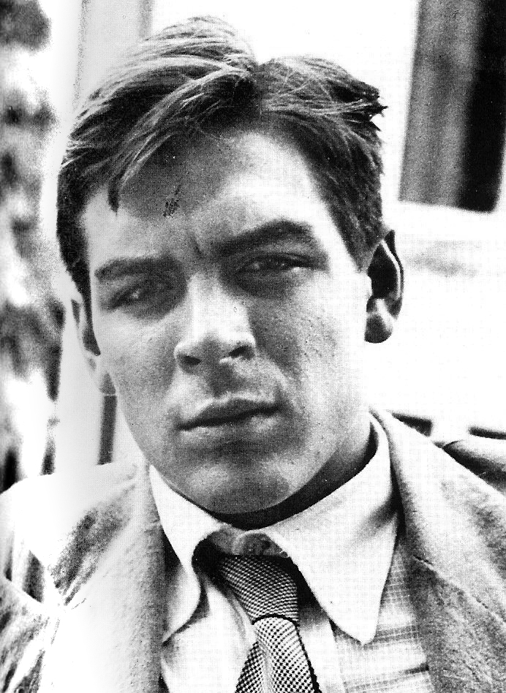
The Motorcycle Diaries- Che Guevara
Pages 57-73
Paddy Stone and Tom Brown

Slide 2
Speculation of the future
TWO ARGENTINE LEPROSY EXPERTS TOUR LATN AMERICA BY MOTORCYCLE
‘The Experts’: Che and Alberto receive new titles as leaders in leprology. They use this newfound title to their personal advantage, exploiting the hospitality of friendly Chilean strangers.
“But we weren’t just anybody now we were the experts…. We were treated like kings”
“the Chileans, exceedingly friendly people, were warm and welcoming wherever we went.”
This change has given the two adventurers the ability to discover a new side of Latin America. The hospitality brightens their future and gives them a place to rest each night and brew their ‘mate’.
Mate: this drink appears as a recurring symbol of the hospitality shared around Latin America.

Slide 3
Speculation of the future
Easter island! The imagination stops in its ascending flight to turn somersaults at the very thought.
Che and Alberto spend much of this section speculating a trip to the theoretical paradise that is ‘Easter Island’. They see it as a land of ‘perfection’ where women do everything, “you just eat, sleep and keep them content.” The only thing ‘apparently’ drawing them there is the possibility of treating a small number of lepers.
This moment appears to the reader as strange, but also a discovery of the deep desires of these two, ‘young boys’ at heart.
“Our project was impossible since the only ship to Easter Island had left and that there wouldn’t be another ship leaving within the year.” Ultimately, the journey to Easter Island does not occur. Though, the reader speculates as to whether it was an attempt to treat lepers, or to escape their journey for a ‘perfect holiday’.

Slide 4
hospitality
“Chilean hospitality, as I never tire of saying, is one reason travelling in our neighboring country is so enjoyable.”
The major discovery recognised by Che and Alberto in this section of the tale is, the depth of Chilean hospitality and the ultimate kindness of all people they approach.
They travel through Temuco, Lautaro, Los Angeles, Santiago and Valparaiso confronting many different types of people but evidently similar hospitality. Che and Alberto discover the different facets of Chilean society while drinking mate and wine, eating fish and tripe, dancing, listening to Latin music and telling tales of past discoveries.
“Today it’s your turn, tomorrow it’ll be mine”-bar owner (hospitality) In Chile there appears to be an ongoing cycle of hospitality that the two travellers discover on their journeys.

Slide 5
Sudden and unexpected
“We had been knights of the road; we belonged to the long-standing ‘wandering aristocracy’ and had calling cards with our impeccable and impressive titles”
Despite its eventual certainty, the loss of La Poderosa is an event that majorly effects Che and Alberto’s plans. Originally they aimed to travel around Latin America on their motorbike but this unexpected change, effects plans and evidently, mindsets.

Slide 6
transformative
Loss of bike – “now we were just two hitchhikers with backpacks, and with all the grime of the road stuck to our overalls, shadows of our former aristocratic selves.”
“motorized bums”- “bums without wheels” This transformation occurs for the two travellers when they finally come to terms with the loss of ‘La Poderosa’. The next stage in their journey (as ‘bums without wheels) is set to be a difficult time.
“Our hobo appearance” – Che and Alberto transform from being medical students to now appearing as hobos. From the top of society to the bottom.

Slide 7
transformative
Another part of the two travellers’ ‘transformative’ discovery arrives when they are offered 200 pesos by their consul in Santiago. They immediately reject this generous offer but realise later that their decision would have been different had they then been in the struggling situation they ultimately ended up in.

Slide 8
Awareness of the world
This small section of Guevara’s diary conveys a transition, particularly for Che, of his awareness of the world around him.
Originally, this awareness is extended by the multitude of hospitality witnessed and shared by the two travellers.
In Valparaiso, Che treats a woman suffering from a heart condition (aggravated by asthma). It is in this encounter that Guevara makes a sudden discovery. He learns of his ‘powerlessness’ in the situation and a desire to change the injustices in society. In this moment Che realises the negative factor the person can become to society.
Guevara also displays an anger towards the government and the plight of the poor. “Those who govern spent less time publicizing their own virtues and more money, much more money, funding socially useful works.

Slide 9
Cultural context
Cultural context: captaining a brigade is a sought-after honour for the most able men in the towns or districts where they operate.
Cultural level of the people is quite low and they do not have much education, or some other factor or all of them put together.

Slide 10
Buzz words
Pesos: the monetary unit of former Spanish colonies (including Chile)
Proletariat: The class of wage-earners in a capitalist society whose only possession of significant material value is their labour-power (their ability to work); a member of such a class is a proletarian.
Mate: a traditional South American, caffeine- rich infused drink
Rapa-Nui: Easter Island
Leprosy: a chronic bacterial infection which deforms the skin
Audacity: a confident and daring quality. Intrepid boldness
Tripe: a type of edible offal from the stomachs of various farm animals
Charango: a small Latin American stringed instrument

Slide 11
Buzz words
Consul: A government official whose job is to live in a foreign country and protect and help the citizens of his or her own country who are traveling, living, or doing business there
Aristocracy: the highest social class in some countries. Typically own land and own more money and power than others in society.
Acrimony: angry and bitter feelings.
Mapuches: an Indigenous people of Chile.

Slide 12
Quotable quotes
“But we weren’t just anybody now we were the experts…. We were treated like kings” (pg. 60)
“Chilean women who, ugly or beautiful, have a certain spontaneity and freshness that captivates immediately” (pg. 64)
“He topped off his generosity by offering us 200 pesos which we, taking righteous offense refused. If he’d offered it three months later, it would’ve been a different story.” (pg. 66)
“We had been knights of the road; we belonged to the long-standing ‘wandering aristocracy’ and had calling cards with our impeccable and impressive titles” (pg. 68)
“Now we were just two hitchhikers with backpacks, and with all the grime of the road stuck to our overalls, shadows of our former aristocratic selves” (pg. 68)

Slide 13
quotable quotes
“Our distended nostrils inhale the poverty with sadistic intensity” (pg. 69)
“Today it’s your turn, tomorrow it’ll be mine” (pg. 70)
“It is there, in the final moments, for people whose farthest horizon has always been tomorrow, that one comprehends the profound tragedy circumscribing the life of the proletariat the world over.” (pg. 70)
“Our project was impossible since the only ship to Easter Island had left and that there wouldn’t be another ship leaving within the year.” (pg. 72)
“Still, it was always consoling to know that some living thing’s well-being depended on our protection.” (pg. 72)

